Slide 1
Data Visualization
Renato R. Maaliw III, DIT
Engineer & Professor 1, College of Engineering
Southern Luzon State University
Lucban, Quezon, Philippines

Slide 2
Why Data Visualization?

Slide 3
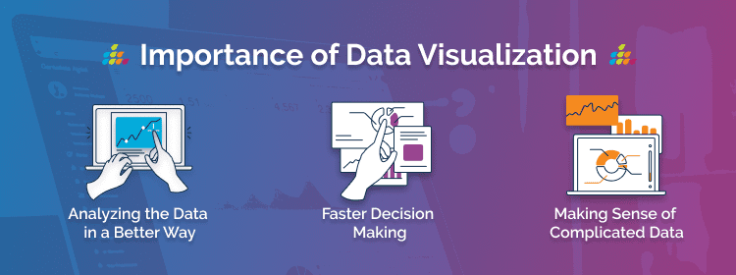
“It bridges the gap between complex data and accessible insights.”

Slide 4

1. Simplifies Complex Data
Visualizations make it easier to understand and interpret complex datasets quickly by summarizing the data in a more digestible form.

Slide 5
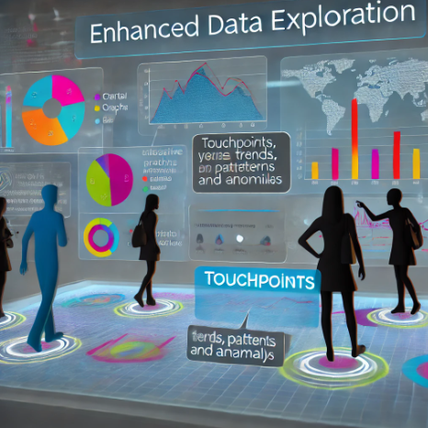
2. Enhances Data Exploration
Visualization tools allow you to explore data interactively, helping identify patterns, trends, and anomalies that you might miss in raw datasets.

Slide 6

3. Supports Better Decision Making
By providing a clear and concise view of data, visualization aids stakeholders in making informed decisions based on evidence rather than assumptions.

Slide 7

4. Reveal Hidden Patterns and Trends
Data visualizations help uncover insights that aren’t immediately apparent, such as seasonality, outliers, and correlations.

Slide 8

5. Improves Communication
Effective visuals can convey findings to both technical and non-technical audiences, ensuring everyone understands the insights being presented.

Slide 9
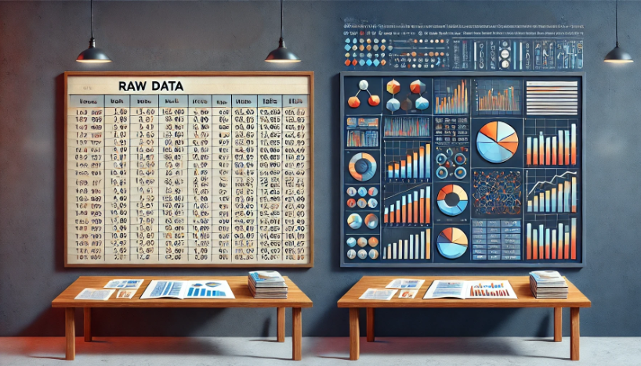

Slide 10
Thank you very much for listening.

